Slide 1
The Foundations: Logic and Proofs
Chapter 1, Part I: Propositional Logic
EECS 1019: Discrete Math for CS Prof. Andy Mirzaian
© 2019 McGraw-Hill Education. All rights reserved. Authorized only for instructor use in the classroom. No reproduction or further distribution permitted without the prior written consent of McGraw-Hill Education.

Slide 2
Chapter Summary
Propositional Logic (aka, Zeroth-Order Logic)
The Language of Propositions
Applications
Logical Equivalences
Predicate Logic (aka, First-Order Logic)
The Language of Quantifiers
Logical Equivalences
Nested Quantifiers
Proofs
Rules of Inference
Proof Methods
Proof Strategy
2

Slide 3
Propositional Logic Summary
The Language of Propositions
Connectives
Truth Values
Truth Tables
Applications
Translating English Sentences
System Specifications
Logic Puzzles
Logic Circuits
Logical Equivalences
Important Equivalences
Showing Equivalence
Satisfiability
3

Slide 4
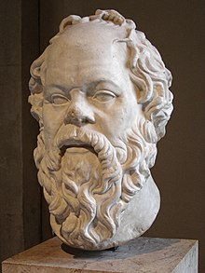
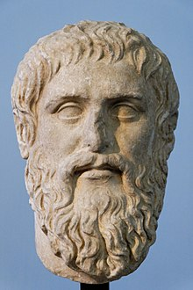
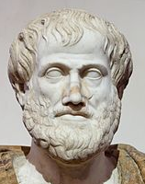
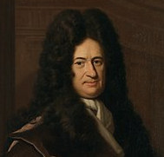
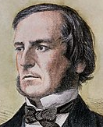
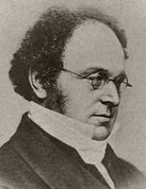
Propositional Logic
Section 1.1
Socrates
(470-399 BC) Philosophy
Plato
(428-348 BC) Philosophy
Aristotle
(384-322 BC) Logic
Gottfried Wilhelm von Leibniz
(1646-1716) Symbolic Logic
George Boole
(1815-1864) Boolean Algebra
Augustus De Morgan (1806-1871) Relational & Universal Algebra
4

Slide 5
Section Summary 1
Propositions
Connectives
Negation
Conjunction
Disjunction
Implication; contrapositive, inverse, converse
Biconditional
Truth Tables
5

Slide 6
Propositions
A proposition is a declarative sentence that is either true or false.
Examples of propositions:
The Moon is made of green cheese.
Trenton is the capital of New Jersey.
Toronto is the capital of Canada.
1 + 0 = 1
0 + 0 = 2
Examples that are not propositions.
Sit down!
What time is it?
x + 1 = 2
x + y = z
6

Slide 7
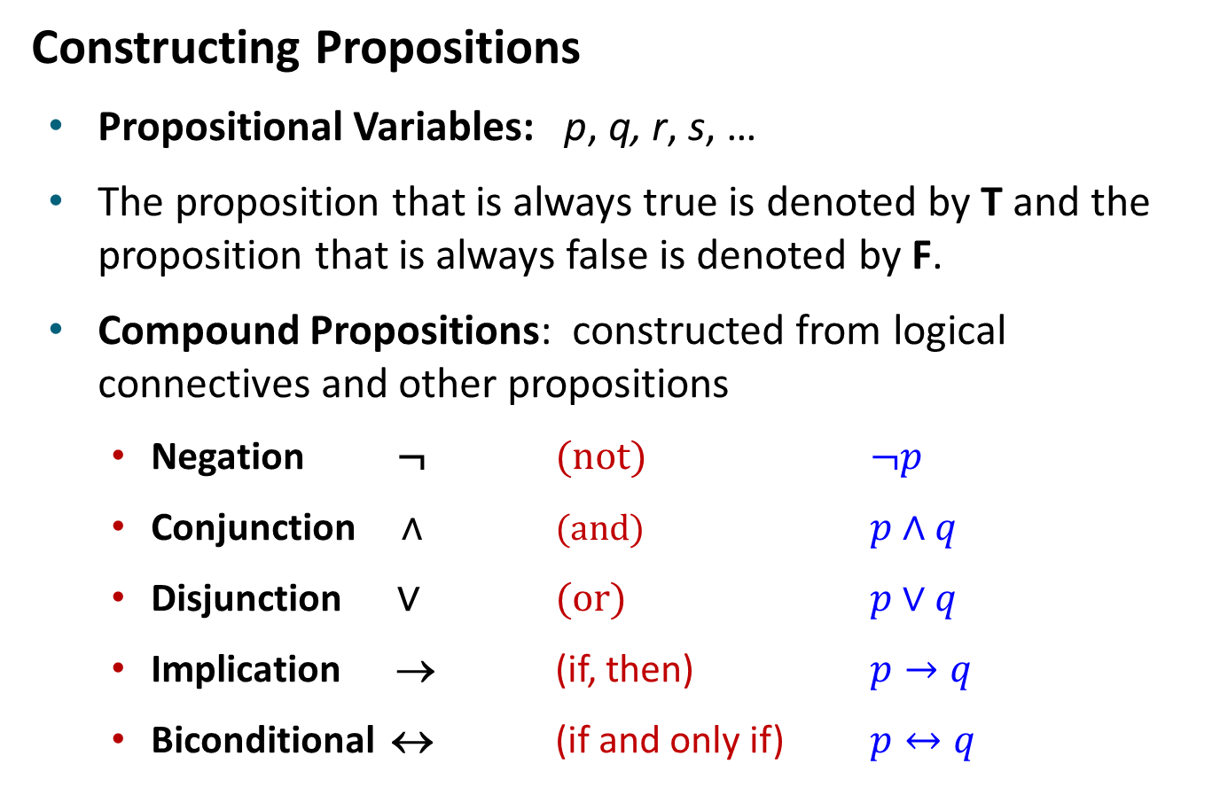
Propositional Logic
Constructing Propositions
Propositional Variables: p, q, r, s, …
The proposition that is always true is denoted by T and the proposition that is always false is denoted by F.
Compound Propositions: constructed from logical connectives and other propositions
Negation ¬ (not) $¬p$
Conjunction ∧ (and) $p∧q$
Disjunction ∨ (or) $p∨q$
Implication → (if, then) $p→q$
Biconditional ↔ (if and only if) $p↔q$
7

Slide 8

Compound Propositions: Negation
The negation of a proposition p is denoted by ¬p and has this truth table:
p | ¬p
T | F
F | T
Example: If p denotes “The earth is round.”, then ¬p denotes “It is not the case that the earth is round,” or more simply “The earth is not round.”
8

Slide 9
Conjunction
The conjunction of propositions p and q is denoted by p ∧ q and has this truth table:
p | q | p ∧ q
T | T | T
T | F | F
F | T | F
F | F | F
Example: If p denotes “I am at home.” and q denotes “It is raining.” then p ∧ q denotes “I am at home and it is raining.”
9

Slide 10
Disjunction
The disjunction of propositions p and q is denoted by p ∨ q and has this truth table:
p | q | p ∨ q
T | T | T
T | F | T
F | T | T
F | F | F
Example: If p denotes “I am at home.” and q denotes “It is raining.” then p ∨ q denotes “I am at home or it is raining.”
10

Slide 11
The Connective Or in English
In English “or” has two distinct meanings.
“Inclusive Or” - In the sentence “Students who have taken CS202 or Math120 may take this class,” we assume that students need to have taken one of the prerequisites, but may have taken both. This is the meaning of disjunction. For p ∨ q to be true, either one or both of p and q must be true.
“Exclusive Or” - When reading the sentence “Soup or salad comes with this entrée,” we do not expect to be able to get both soup and salad. This is the meaning of Exclusive Or (Xor). In p ⊕ q , one of p and q must be true, but not both. The truth table for ⊕ is:
p | q | p ⊕ q
T | T | F
T | F | T
F | T | T
F | F | F
11

Slide 12
Implication
If p and q are propositions, then p → q is a conditional statement or implication which is read as “if p, then q” and has this truth table:
p | q | p → q
T | T | T
T | F | F
F | T | T
F | F | T
Example: If p denotes “I am at home.” and q denotes “It is raining.” then p → q denotes “If I am at home then it is raining.”
In p → q, p is the hypothesis (antecedent or premise) and q is the conclusion (or consequence).
12

Slide 13
Understanding Implication 1
In p → q there does not need to be any connection between the antecedent or the consequent. The “meaning” of p → q depends only on the truth values of p and q.
These implications are perfectly fine, but would not be used in ordinary English.
“If the moon is made of green cheese, then I have more money than Bill Gates. ”
“If the moon is made of green cheese, then I’m on welfare.”
“If 1 + 1 = 3, then your grandma wears combat boots.”
13

Slide 14
Understanding Implication 2
One way to view the logical conditional is to think of an obligation or contract.
“If I am elected, then I will lower taxes.”
“If you get 100% on the final, then you will get an A+.”
If the politician is elected and does not lower taxes, then the voters can say that he or she has broken the campaign pledge. Something similar holds for the professor. This corresponds to the case where p is true and q is false.
14

Slide 15
Different Ways of Expressing p → q
if p, then q
if p, q
q unless ¬p
q if p
q whenever p
q follows from p
p implies q
p only if q
q when p
p is sufficient for q
q is necessary for p
a necessary condition for p is q
a sufficient condition for q is p
15

Slide 16
Converse, Contrapositive, and Inverse
From p → q we can form new conditional statements .
q → p is the converse of p → q
¬q → ¬p is the contrapositive of p → q
¬p → ¬q is the inverse of p → q
Example: Find the converse, inverse, and contrapositive of “It raining is a sufficient condition for my not going to town.”
Solution:
converse: If I do not go to town, then it is raining.
inverse: If it is not raining, then I will go to town.
contrapositive: If I go to town, then it is not raining.
16

Slide 17
Biconditional
If p and q are propositions, then we can form the biconditional proposition p ↔ q, read as “p if and only if q .” The biconditional p ↔ q denotes the proposition with this truth table:
p | q | p ↔ q
T | T | T
T | F | F
F | T | F
F | F | T
Example: If p denotes “I am at home.” and q denotes “It is raining.” then p ↔ q denotes “I am at home if and only if it is raining.”
17

Slide 18
Expressing the Biconditional
Some alternative ways that “p if and only if q” is expressed in English:
p is necessary and sufficient for q
if p then q, and conversely
p iff q
18

Slide 19
Truth Tables For Compound Propositions
Construction of a truth table:
Rows
Need a row for every possible combination of values for the atomic propositions.
Columns
Need a column for the compound proposition (usually at far right)
Need a column for the truth value of each expression that occurs in the compound proposition as it is built up.
This includes the atomic propositions
19

Slide 20
Example Truth Table
Construct a truth table for p ∨ q → ¬r
p | q | r | ¬r | p ∨ q | p ∨ q → ¬r
T | T | T | F | T | F
T | T | F | T | T | T
T | F | T | F | T | F
T | F | F | T | T | T
F | T | T | F | T | F
F | T | F | T | T | T
F | F | T | F | F | T
F | F | F | T | F | T
20

Slide 21
Equivalent Propositions
Two propositions are equivalent if they always have the same truth value.
Example: Show using a truth table that the conditional is equivalent to the contrapositive.
Solution:
p | q | ¬p | ¬q | p → q | ¬q → ¬p
T | T | F | F | T | T
T | F | F | T | F | F
F | T | T | F | T | T
F | F | T | T | T | T
21

Slide 22
Using a Truth Table to Show Non-Equivalence
Example: Using truth table show that implication is not equivalent to its inverse nor to its converse.
Solution:
p | q | ¬p | ¬q | p → q | ¬p → ¬q | q → p
T | T | F | F | T | T | T
T | F | F | T | F | T | T
F | T | T | F | T | F | F
F | F | T | T | T | T | T
22

Slide 23
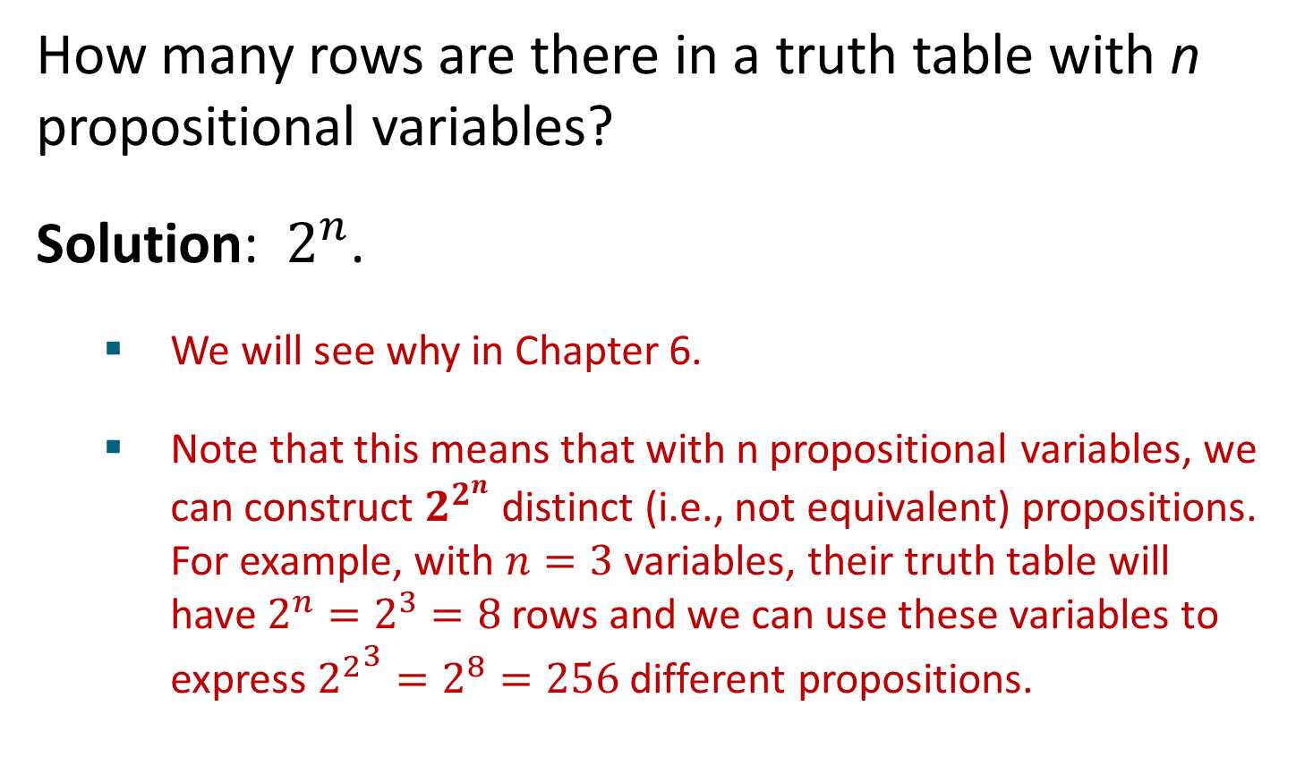
Problem
How many rows are there in a truth table with n propositional variables?
Solution: $2^{n}$.
We will see why in Chapter 6.
Note that this means that with n propositional variables, we can construct $2^{2^{n}}$distinct (i.e., not equivalent) propositions. For example, with $n=3$ variables, their truth table will have $2^{n}=2^{3}=8$ rows and we can use these variables to express ${2^{2}}^{3}=2^{8}=256$ different propositions.
23

Slide 24
Precedence of Logical Operators
Operator | Precedence
¬ | 1
∧ | 2
∨ | 3
→ | 4
↔ | 5
p ∨ q → ¬r is equivalent to (p ∨ q) → ¬r
If the intended meaning is p ∨(q → ¬r)
then parentheses must be used.
24

Slide 25
Applications of Propositional Logic
Section 1.2
25

Slide 26
Applications of Propositional Logic: Summary
Translating English to Propositional Logic
System Specifications
Boolean Searching
Logic Puzzles
Logic Circuits
AI Diagnosis Method (not covered)
26

Slide 27
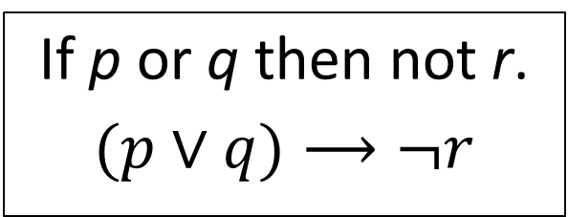
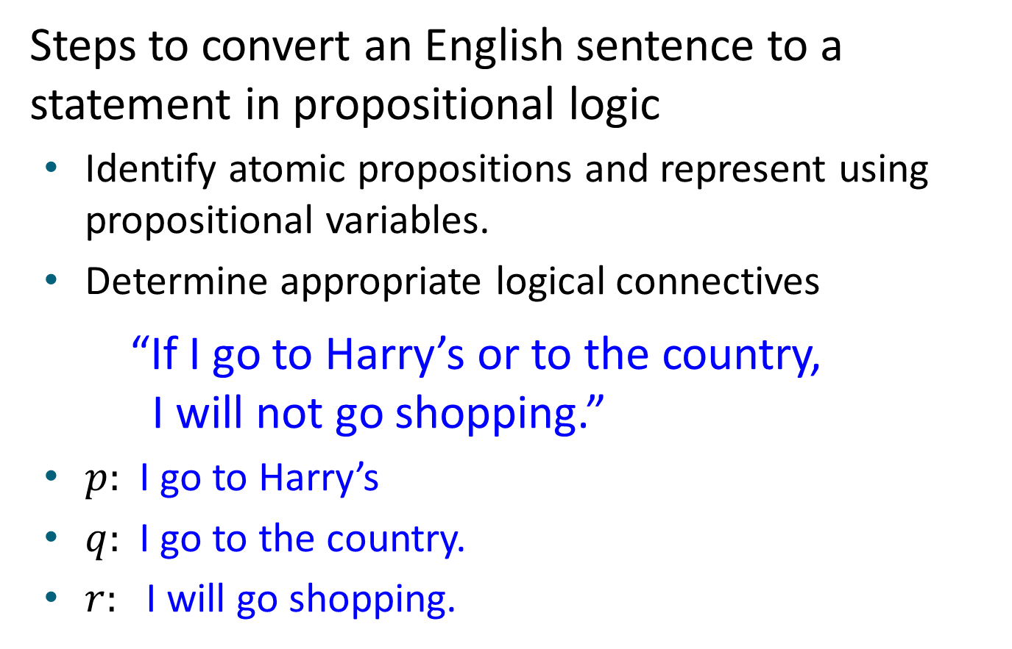
Translating English Sentences
Steps to convert an English sentence to a statement in propositional logic
Identify atomic propositions and represent using propositional variables.
Determine appropriate logical connectives
“If I go to Harry’s or to the country, I will not go shopping.”
$p:$I go to Harry’s
$q:$I go to the country.
$r:$I will go shopping.
If p or q then not r.
$$(p∨q)⟶¬r$$
27

Slide 28
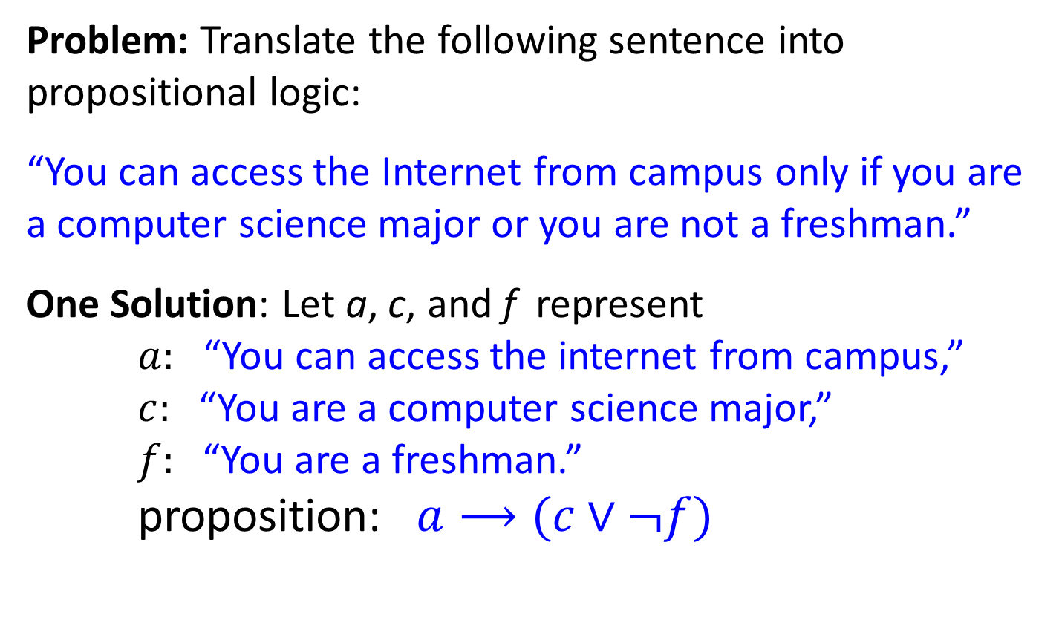
Example
Problem: Translate the following sentence into propositional logic:
“You can access the Internet from campus only if you are a computer science major or you are not a freshman.”
One Solution: Let a, c, and f represent $a:$“You can access the internet from campus,” $c:$“You are a computer science major,” $f:$“You are a freshman.” proposition: $a⟶(c∨¬f)$
28

Slide 29
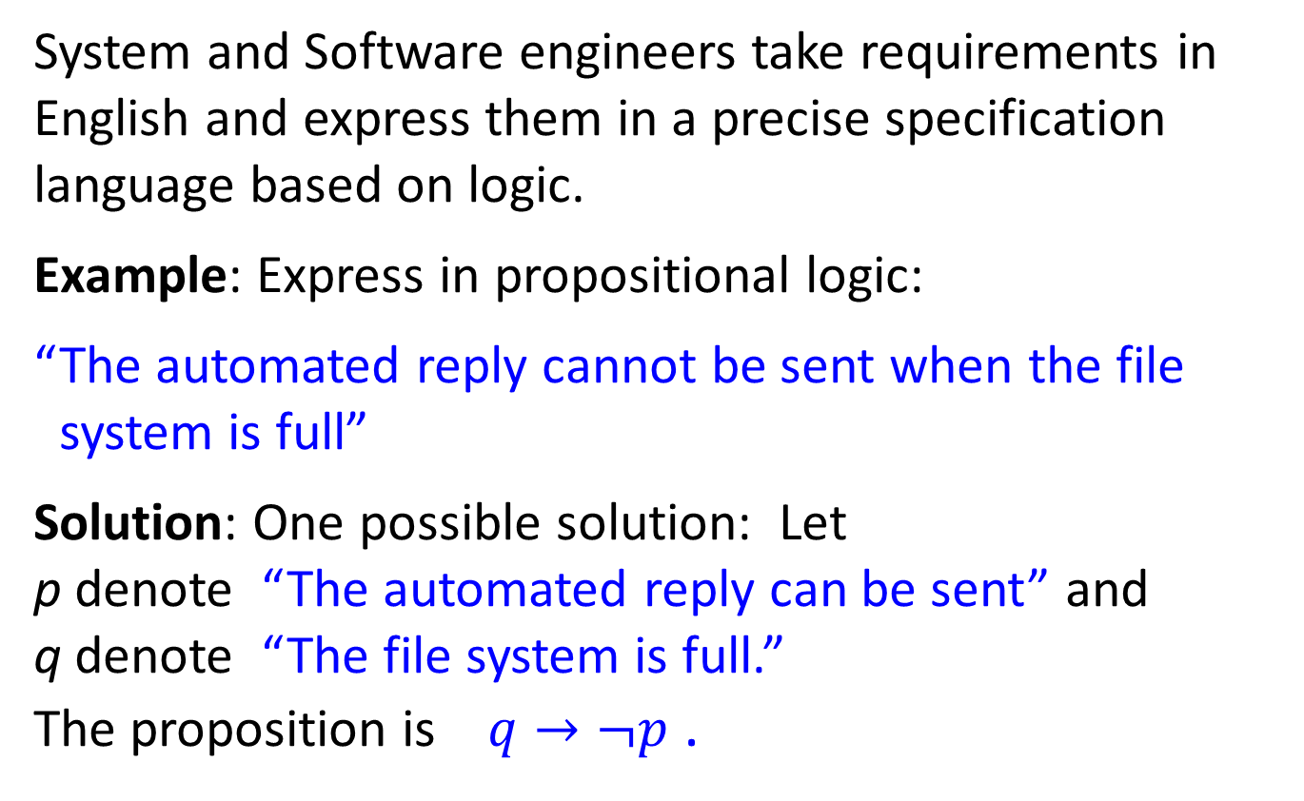
System Specifications
System and Software engineers take requirements in English and express them in a precise specification language based on logic.
Example: Express in propositional logic:
“The automated reply cannot be sent when the file system is full”
Solution: One possible solution: Let p denote “The automated reply can be sent” and q denote “The file system is full.” The proposition is $q→¬p$ .
29

Slide 30
Consistent System Specifications
Definition: A list of propositions is consistent if it is possible to assign truth values to the proposition variables so that each proposition is true.
Exercise: Are these specifications consistent?
“The diagnostic message is stored in the buffer or it is retransmitted.”
“The diagnostic message is not stored in the buffer.”
“If the diagnostic message is stored in the buffer, then it is retransmitted.”
Solution: Let p denote “The diagnostic message is stored in the buffer.” Let q denote “The diagnostic message is retransmitted” The specification can be written as: p ∨ q, ¬p, p → q. When p is false and q is true all three statements are true. So the specification is consistent.
What if “The diagnostic message is not retransmitted” is added.
Solution: Now we are adding ¬q and there is no satisfying assignment. So the specification is not consistent.
30

Slide 31
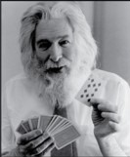
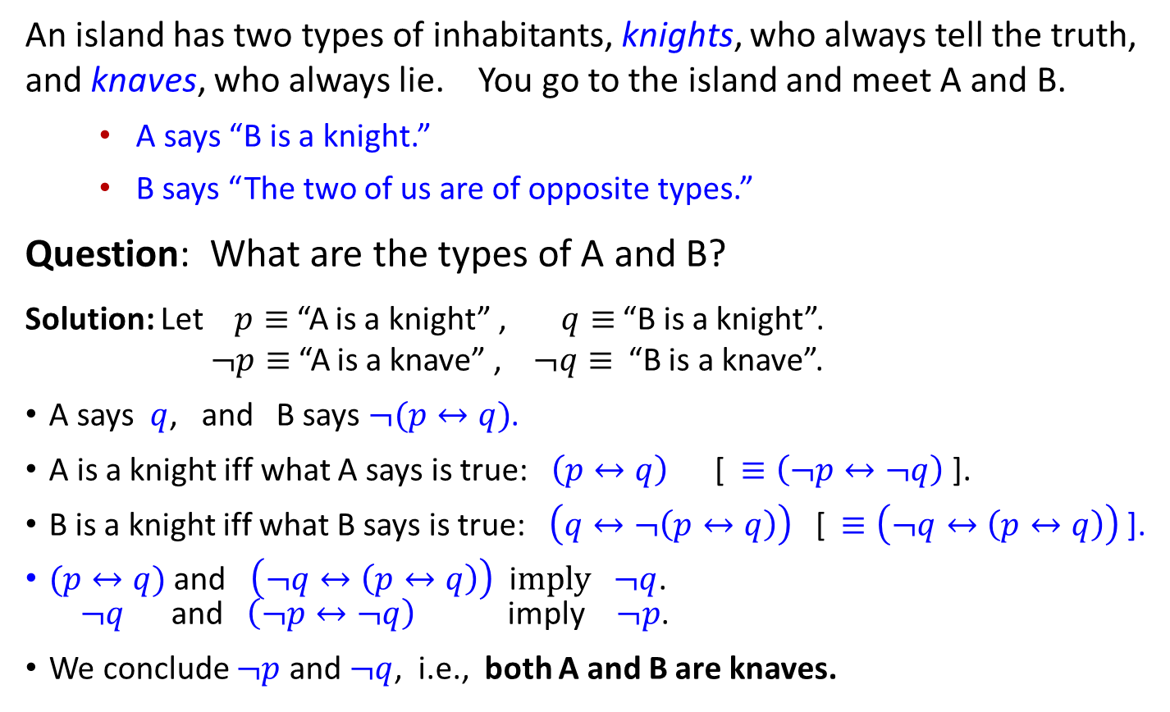
Logic Puzzles
Raymond Smullyan (1919-2017)
An island has two types of inhabitants, knights, who always tell the truth, and knaves, who always lie. You go to the island and meet A and B.
A says “B is a knight.”
B says “The two of us are of opposite types.”
Question: What are the types of A and B?
Solution: Let $p≡$“A is a knight” , $q≡$ “B is a knight”. $¬p≡$“A is a knave” , $¬q≡$ “B is a knave”.
A says $q$, and B says $¬(p↔q)$.
A is a knight iff what A says is true:$\left(p↔q\right)$ [ $≡\left(¬p↔¬q\right)$ ].
B is a knight iff what B says is true: $\left(q↔¬\left(p↔q\right)\right)$ [$≡\left(¬q↔\left(p↔q\right)\right)$ ].
$(p↔q)$ and $\left(¬q↔\left(p↔q\right)\right)$ i$mply ¬q$. $¬q$ and $\left(¬p↔¬q\right)$ imply $¬p$.
We conclude $¬p$ and $¬q$, i.e., both A and B are knaves.
31

Slide 32
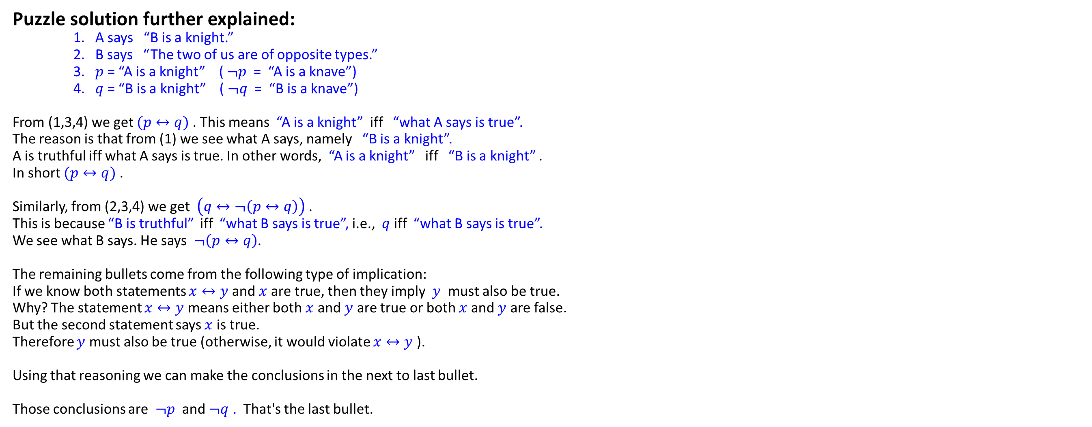
Puzzle solution further explained: 1. A says “B is a knight.” 2. B says “The two of us are of opposite types.” 3. $p$ = “A is a knight” ( $¬p$= “A is a knave”) 4. $q$ = “B is a knight” ($¬q$ = “B is a knave”) From (1,3,4) we get $(p↔q)$. This means “A is a knight” iff “what A says is true”. The reason is that from (1) we see what A says, namely “B is a knight”. A is truthful iff what A says is true. In other words, “A is a knight” iff “B is a knight” . In short $(p↔q)$. Similarly, from (2,3,4) we get $\left(q↔¬\left(p↔q\right)\right)$ . This is because “B is truthful” iff “what B says is true”, i.e., $q$ iff “what B says is true”. We see what B says. He says $¬\left(p↔q\right)$. The remaining bullets come from the following type of implication: If we know both statements $x↔y$and $x$are true, then they imply $y$ must also be true. Why? The statement $x↔y$means either both $x$ and $y$ are true or both $x$ and $y$ are false. But the second statement says $x$ is true. Therefore $y$ must also be true (otherwise, it would violate $x↔y$). Using that reasoning we can make the conclusions in the next to last bullet. Those conclusions are $¬p$ and $¬q$ . That's the last bullet.

Slide 33
Propositional Equivalences
Section 1.3
33

Slide 34
Section Summary 2
Tautologies, Contradictions, Contingencies.
Logical Equivalence
Important Logical Equivalences
Showing Logical Equivalence
Normal Forms
Disjunctive Normal Form
Conjunctive Normal Form
Propositional Satisfiability
Sudoku Example
34

Slide 35
Tautologies, Contradictions, and Contingencies
A tautology is a proposition which is always true.
Example: p ∨ ¬p
A contradiction is a proposition which is always false.
Example: p ∧ ¬p
A contingency is a proposition which is neither a tautology nor a contradiction, such as p
P | ¬p | p ∨ ¬p | p ∧ ¬p
T | F | T | F
F | T | T | F
35

Slide 36
Logically Equivalent
Two compound propositions p and q are logically equivalent if p ↔ q is a tautology.
We write this as p ⇔ q or as p ≡ q where p and q are compound propositions.
Two compound propositions p and q are equivalent if and only if the columns in a truth table giving their truth values agree.
This truth table shows that ¬p ∨ q is equivalent to p → q.
p | q | ¬p | ¬p ∨ q | p → q
T | T | F | T | T
T | F | F | F | F
F | T | T | T | T
F | F | T | T | T
36

Slide 37
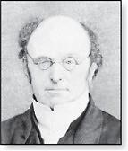
De Morgan’s Laws
Augustus De Morgan 1806-1871
This truth table shows that De Morgan’s Second Law holds.
p | q | ¬p | ¬q | (p ∨ q) | ¬(p ∨ q) | ¬p ∧ ¬q
T | T | F | F | T | F | F
T | F | F | T | T | F | F
F | T | T | F | T | F | F
F | F | T | T | F | T | T
37

Slide 38
Key Logical Equivalences 1
Identity Laws:
Domination Laws:
Idempotent laws:
Double Negation Law:
Negation Laws:
38

Slide 39
Key Logical Equivalences 2
Commutative Laws:
Associative Laws:
Distributive Laws:
Absorption Laws: $p∨\left(p∧q\right)≡p, p∧\left(p∨q\right)≡p$
39

Slide 40
More Logical Equivalences
TABLE 7 Logical Equivalences Involving Conditional Statements.
TABLE 8 Logical Equivalences Involving Biconditional Statements.
40

Slide 41
Constructing New Logical Equivalences
We can show that two expressions are logically equivalent by developing a series of logically equivalent statements.
To prove that A ≡ B we produce a series of equivalences beginning with A and ending with B.
Keep in mind that whenever a proposition (represented by a propositional variable) occurs in the equivalences listed earlier, it may be replaced by an arbitrarily complex compound proposition.
41

Slide 42

Equivalence Proofs 1
Example: Show that
is logically equivalent to
Solution:
by the second De Morgan law
by the first De Morgan law
by the double negation law
by the second distributive law
because $¬p∧p=F$
by the commutative law for disjunction
by the identity law for F
42

Slide 43
Equivalence Proofs 2
Example: Show that
is a tautology.
Solution:
by truth table for →
by the first De Morgan law
by associative and commutative laws laws for disjunction
by truth tables
by the domination law
43

Slide 44


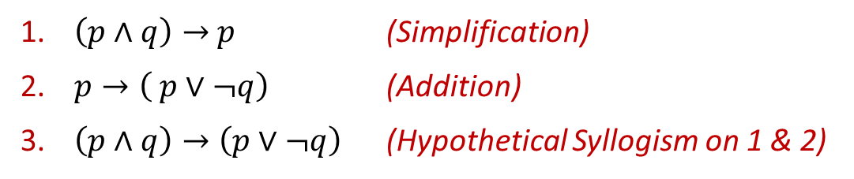
How to prove a tautology
Three ways to prove a given proposition $p$ is a tautology:
[Brute Force] Use the truth table technique.
[Simplification] Starting from $p$, use a sequence of equivalences to simplify it to $T$ (true): $p≡p_{1}≡p_{2}≡⋯≡p_{n}≡T.$
[Inference] Prove $T→p$ by an inference rule (then use Modus Ponens to infer $p$). Instead of $T$ (true), we can use any already established tautology. We can even use a sequence of such inference rules starting from established tautologies and infer new tautologies from them.
Revisit this after
Chapter 1 – Part 3
slides
Example: Prove $\left(p∧q\right)→\left(p∨¬q\right)$ is a tautology.
Proof:
$\left(p∧q\right)→$ $p$ (Simplification)
$p→\left( p∨¬q\right)$ (Addition)
$\left(p∧q\right)→\left(p∨¬q\right)$ (Hypothetical Syllogism on 1 & 2)
44

Slide 45
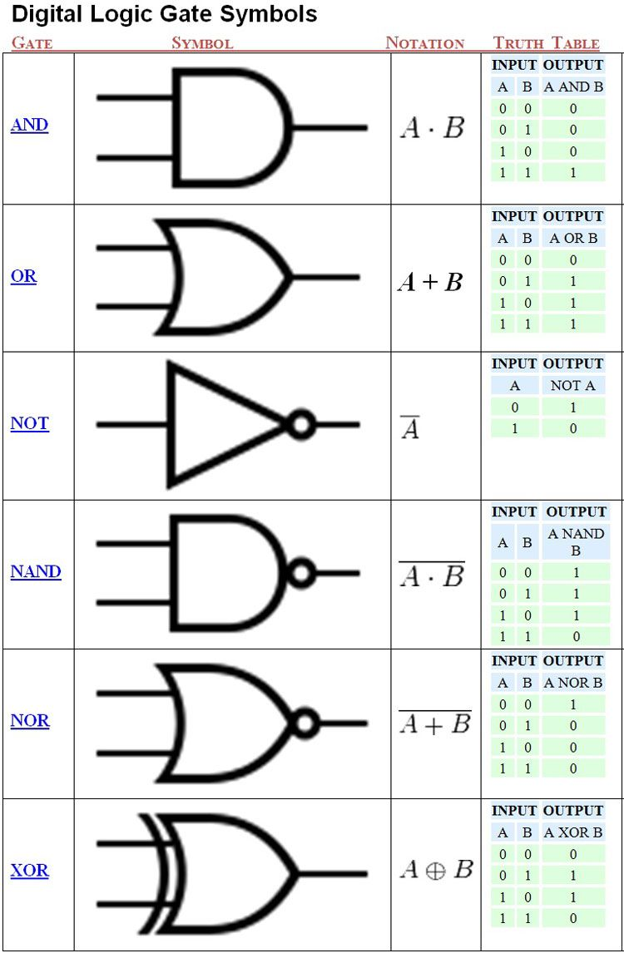

















Digital Logic Gates
$$A$$
$$A$$
NOT
$$¬A$$
NAND
$$¬(A∧B)$$
$$B$$
$$A$$
$$A$$
AND
NOR
$$A∧B$$
$$¬(A∨B)$$
$$B$$
$$B$$
$$A$$
$$A$$
OR
XOR
$$A∨B$$
$$A⊕B$$
$$B$$
$$B$$
Some gates can be simulated by a combination of other gates.
Is there any single gate that can simulate all others?
45

Slide 46
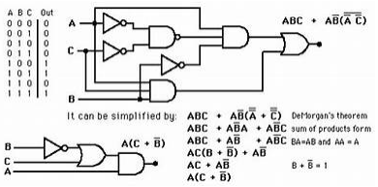
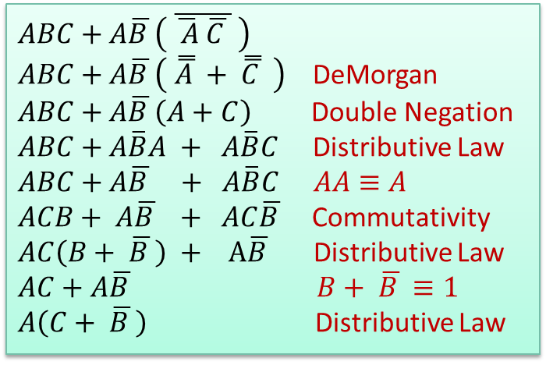
Digital Logic Circuits
Out
This circuit can be simplified to:
$ABC+A\overline{B }\left( \overline{\overline{ A} \overline{C }} \right)$
$ABC+A\overline{B }\left( \overset{̿}{A }+ \overset{̿}{C } \right)$ DeMorgan
$ABC+A\overline{B }\left(A+C\right)$ Double Negation
$ABC+A\overline{B}A + A\overline{B}C$ Distributive Law
$ABC+A\overline{B } + A\overline{B}C$ $AA≡A$
$ACB+ A\overline{B } + AC\overline{B }$ Commutativity
$AC\left(B+ \overline{B }\right) + A\overline{B }$ Distributive Law
$AC+A\overline{B }$ $B+ \overline{B }≡1$
$A\left(C+ \overline{B }\right)$ Distributive Law
46

Slide 47
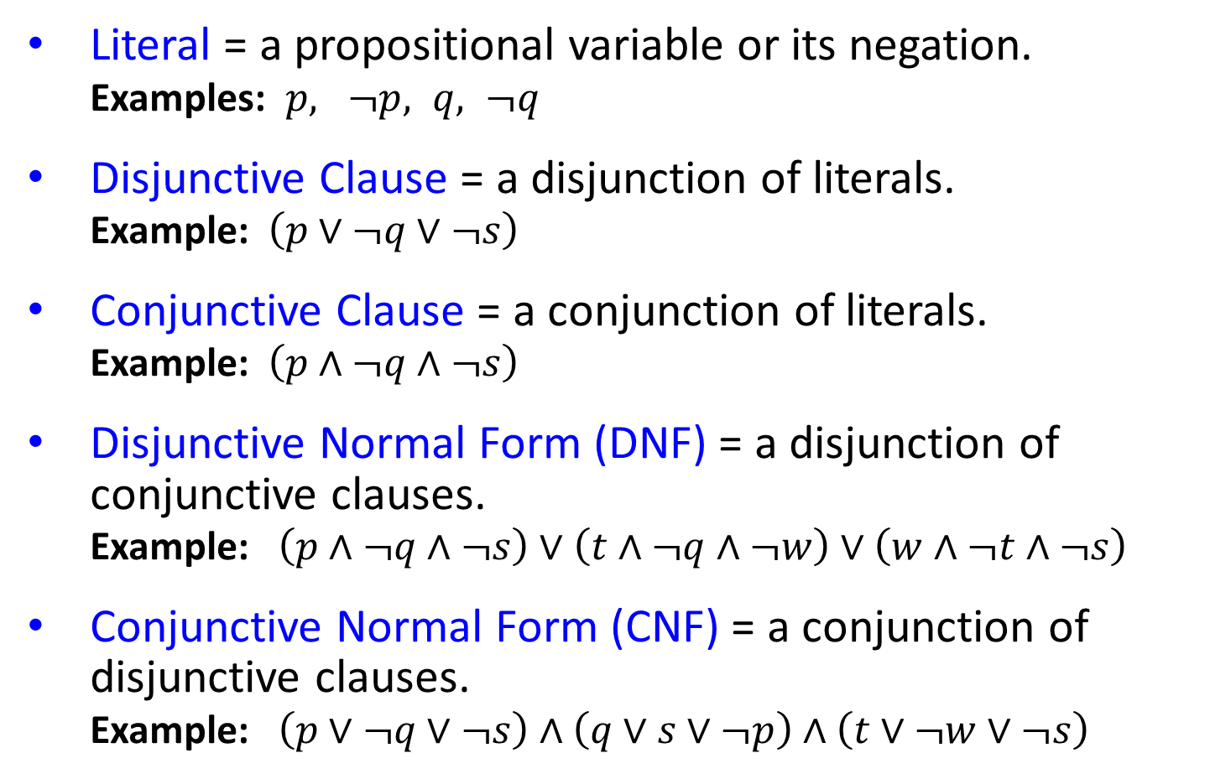
Normal Forms
Literal = a propositional variable or its negation. Examples: $p, ¬p, q, ¬q$
Disjunctive Clause = a disjunction of literals. Example: $\left(p∨¬q∨¬s\right)$
Conjunctive Clause = a conjunction of literals. Example: $\left(p∧¬q∧¬s\right)$
Disjunctive Normal Form (DNF) = a disjunction of conjunctive clauses. Example: $\left(p∧¬q∧¬s\right)∨\left(t∧¬q∧¬w\right)$ $∨\left(w∧¬t∧¬s\right)$
Conjunctive Normal Form (CNF) = a conjunction of disjunctive clauses. Example: $\left(p∨¬q∨¬s\right)$ $∧$ $\left(q∨s∨¬p\right)$ $∧$ $\left(t∨¬w∨¬s\right)$
47

Slide 48
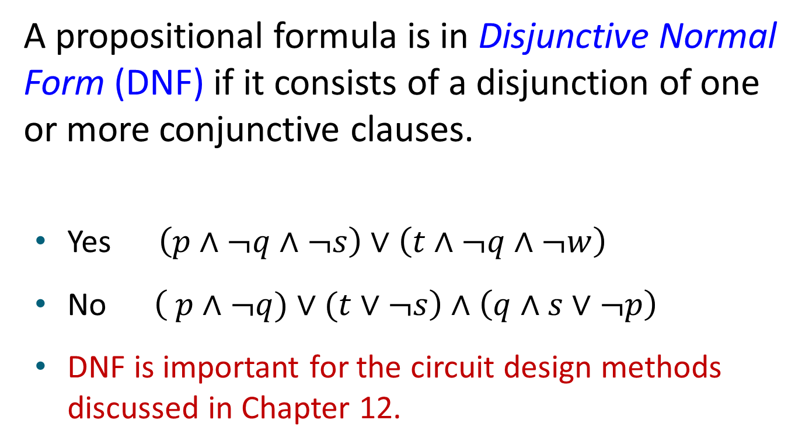
Disjunctive Normal Form1
A propositional formula is in Disjunctive Normal Form (DNF) if it consists of a disjunction of one or more conjunctive clauses.
Yes $\left(p∧¬q∧¬s\right)∨\left(t∧¬q∧¬w\right)$
No $\left( p∧¬q)∨(t∨¬s\right)$ $∧$ $\left(q∧s∨¬p\right)$
DNF is important for the circuit design methods discussed in Chapter 12.
48

Slide 49
Disjunctive Normal Form2
Example: Show that every compound proposition can be put in disjunctive normal form.
Solution: Construct the truth table for the proposition. Then an equivalent proposition is the disjunction with m conjunctive clauses (where m is the number of rows for which the formula evaluates to T). Each clause has n literals where n is the number of distinct propositional variables. Each literal in that clause is the positive form of a variable if the variable is assigned T in that row, and in negative form if that variable is assigned F in that row. This proposition is in disjunctive normal from.
49

Slide 50
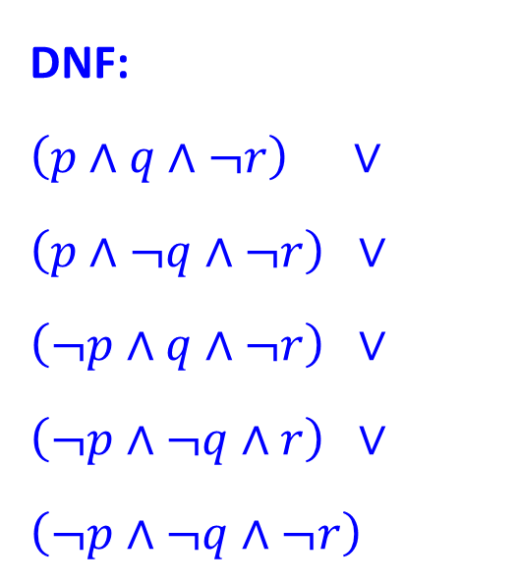
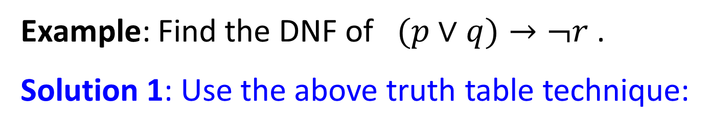
Disjunctive Normal Form3
Example: Find the DNF of $(p∨q)→¬r$ .
Solution 1: Use the above truth table technique:
DNF: $$\left(p∧q∧¬r\right) ∨$$
$$\left(p∧¬q∧¬r\right) ∨$$
$$\left(¬p∧q∧¬r\right) ∨$$
$$\left(¬p∧¬q∧r\right) ∨$$
$$\left(¬p∧¬q∧¬r\right)$$
p | q | r | ¬r | p ∨ q | p ∨ q → ¬r
T | T | T | F | T | F
T | T | F | T | T | T
T | F | T | F | T | F
T | F | F | T | T | T
F | T | T | F | T | F
F | T | F | T | T | T
F | F | T | F | F | T
F | F | F | T | F | T
50

Slide 51
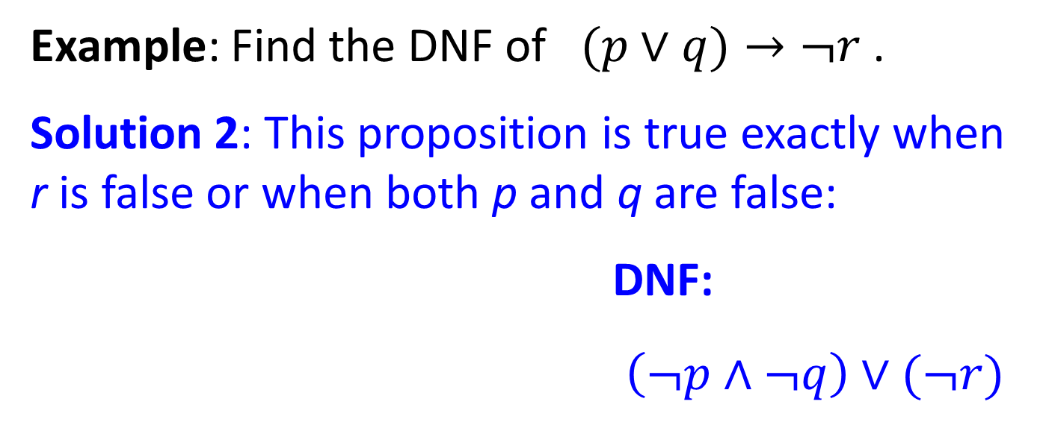
Disjunctive Normal Form3
Example: Find the DNF of $(p∨q)→¬r$ .
Solution 2: This proposition is true exactly when r is false or when both p and q are false:
DNF:
$\left(¬p∧¬q\right)∨(¬r)$
p | q | r | ¬r | p ∨ q | p ∨ q → ¬r
T | T | T | F | T | F
T | T | F | T | T | T
T | F | T | F | T | F
T | F | F | T | T | T
F | T | T | F | T | F
F | T | F | T | T | T
F | F | T | F | F | T
F | F | F | T | F | T
51

Slide 52
Conjunctive Normal Form1
A compound proposition is in Conjunctive Normal Form (CNF) if it is a conjunction of disjunctive clauses.
Every proposition can be put in an equivalent CNF.
Conjunctive Normal Form (CNF) can be obtained by repeated application of equivalence laws such as:
eliminating implications,
moving negation inwards using De Morgan’s Laws,
applying distributive, associative, and other laws.
CNF is important in resolution theorem proving used in Artificial Intelligence (AI).
52

Slide 53

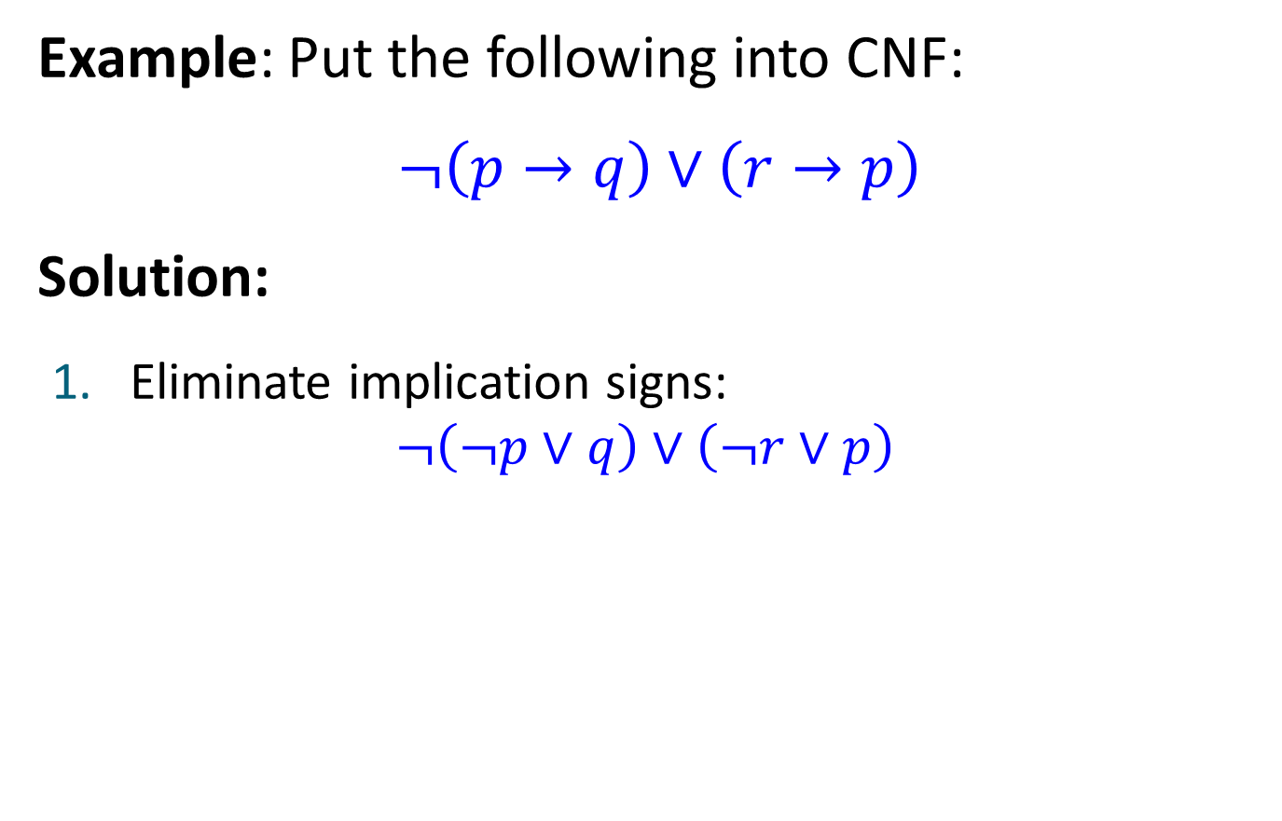

Conjunctive Normal Form2
Example: Put the following into CNF:
$¬\left(p→q\right)∨\left(r→p\right)$
Solution:
Eliminate implication signs: $¬\left(¬p∨q\right)∨\left(¬r∨p\right)$
Move negation inwards; eliminate double negation: $\left(p∧¬q\right)∨\left(¬r∨p\right)$
Convert to CNF using associative/distributive laws: $\left(p∨¬r∨p\right)∧\left(¬q∨¬r∨p\right)$
53

Slide 54
Propositional Satisfiability
A compound proposition is satisfiable if there is an assignment of truth values to its variables that make it true. When no such assignments exist, the compound proposition is unsatisfiable.
A compound proposition is unsatisfiable if and only if its negation is a tautology.
54

Slide 55
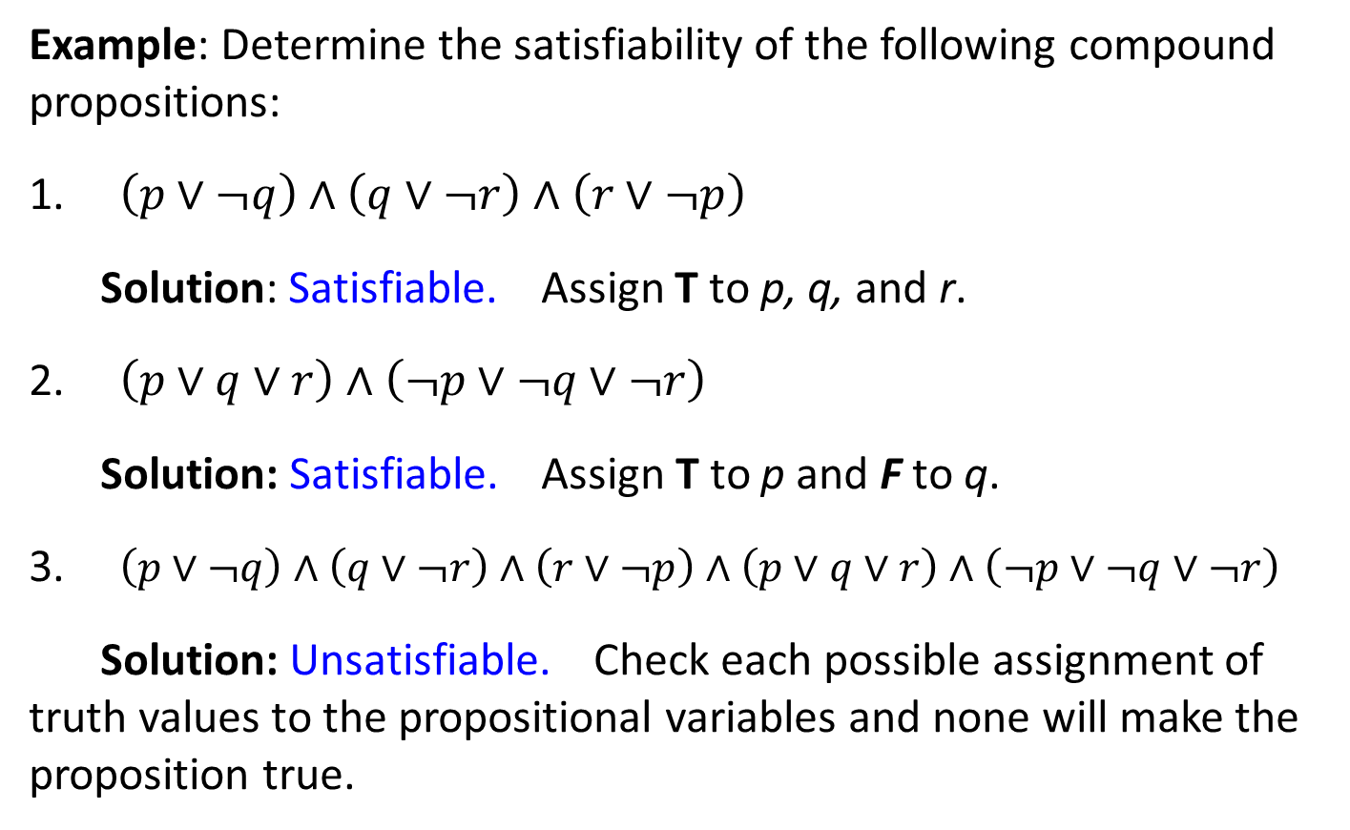
Questions on Propositional Satisfiability
Example: Determine the satisfiability of the following compound propositions:
$\left(p∨¬q\right)∧\left(q∨¬r\right)∧\left(r∨¬p\right)$
Solution: Satisfiable. Assign T to p, q, and r.
$\left(p∨q∨r\right)∧\left(¬p∨¬q∨¬r\right)$
Solution: Satisfiable. Assign T to p and F to q.
$\left(p∨¬q\right)∧\left(q∨¬r\right)∧\left(r∨¬p\right)∧\left(p∨q∨r\right)∧\left(¬p∨¬q∨¬r\right)$
Solution: Unsatisfiable. Check each possible assignment of truth values to the propositional variables and none will make the proposition true.
55

Slide 56
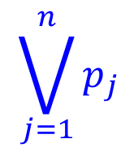
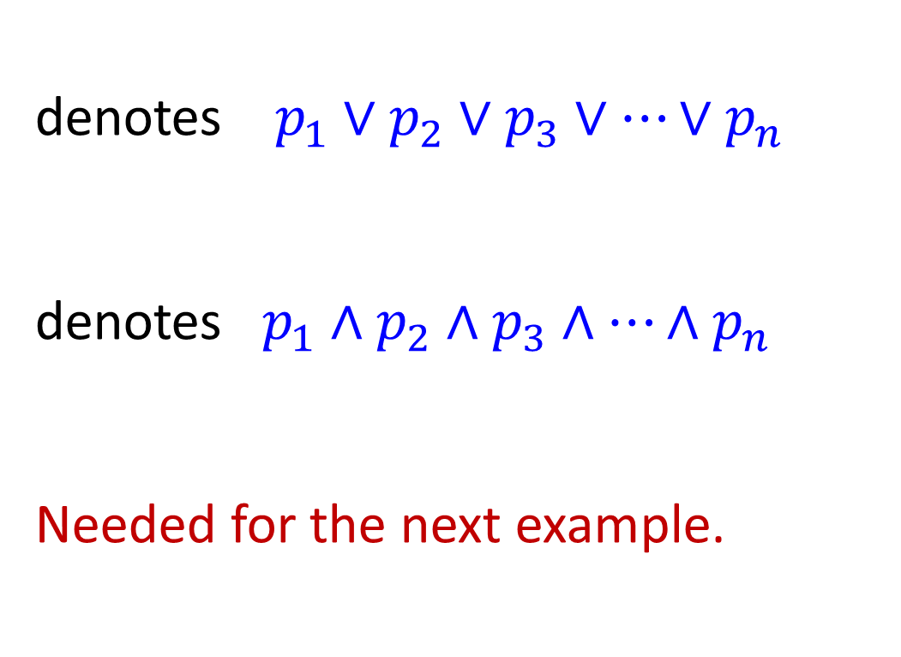
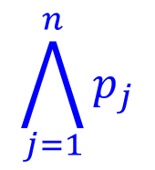
Notation
denotes $p_{1}∨p_{2}∨p_{3}∨…∨p_{n}$
denotes $p_{1}∧p_{2}∧p_{3}∧…∧p_{n}$
Needed for the next example.
$$\bigvee_{j=1}^{n}{p_{j}}$$
$$\bigwedge_{j=1}^{n}{p_{j}}$$
56

Slide 57
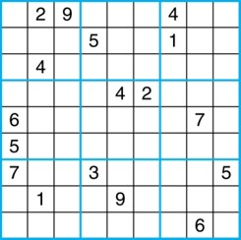
Sudoku
A Sudoku puzzle is represented by a 9×9 grid made up of nine 3×3 subgrids, known as blocks. Some of the 81 cells of the puzzle are assigned one of the numbers 1,2, …, 9.
The puzzle is solved by assigning numbers to each blank cell so that every row, column and block contains each of the nine possible numbers.
Example:
57

Slide 58
Encoding as a Satisfiability Problem 1
Let p(i, j, n) denote the proposition that is true when the number n is in the cell in the i^{th} row and the j^{th} column.
There are 9 × 9 × 9 = 729 such propositions.
In the sample puzzle p(5,1,6) is true, but p(5,j,6) is false for j = 2,3,…9
58

Slide 59
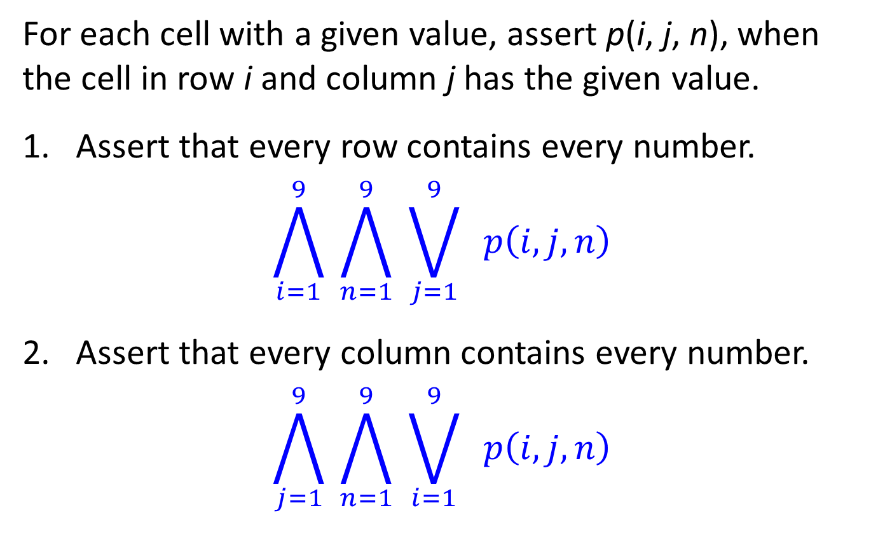
Encoding as a Satisfiability Problem 2
For each cell with a given value, assert p(i, j, n), when the cell in row i and column j has the given value.
Assert that every row contains every number.
$$\bigwedge_{i=1}^{9}{ \bigwedge_{n=1}^{9}{ \bigvee_{j=1}^{9}{ p\left(i, j, n\right)}}}$$
Assert that every column contains every number.
$$\bigwedge_{j=1}^{9}{ \bigwedge_{n=1}^{9}{ \bigvee_{i=1}^{9}{ p\left(i, j, n\right)}}}$$
59

Slide 60
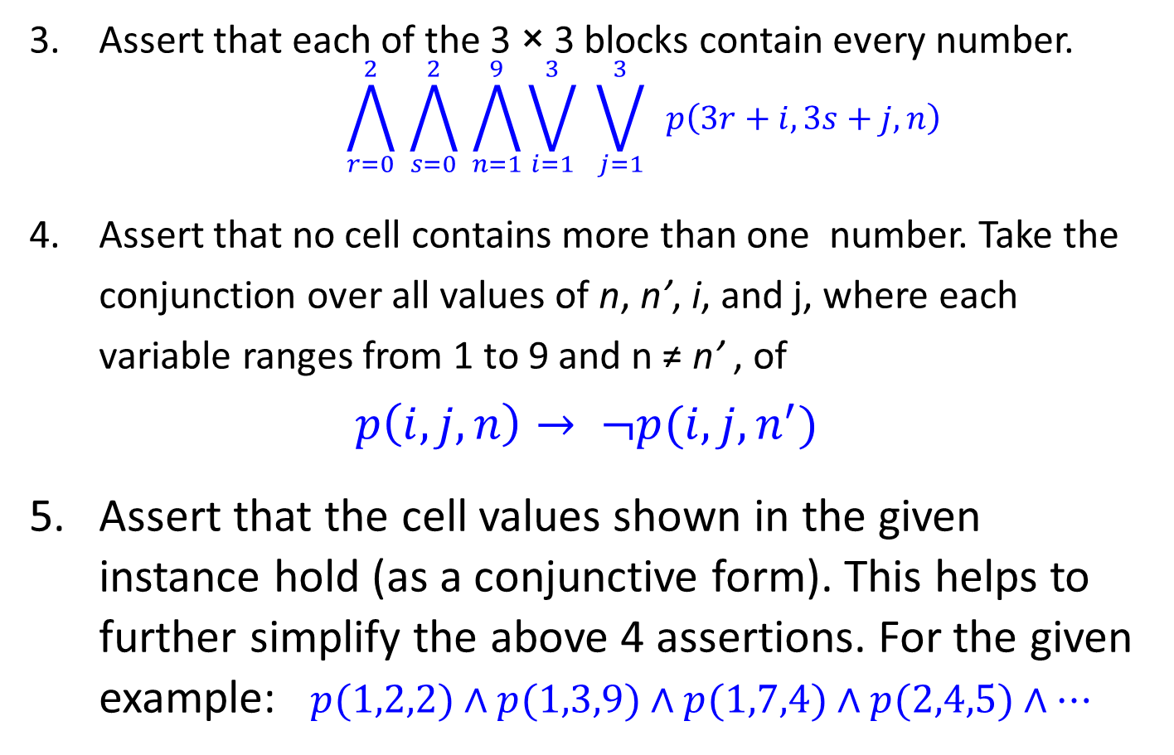
Encoding as a Satisfiability Problem 3
Assert that each of the 3 × 3 blocks contain every number.
$$\bigwedge_{r=0}^{2}{ \bigwedge_{s=0}^{2}{ \bigwedge_{n=1}^{9}{\bigvee_{i=1}^{3}{ }\bigvee_{j=1}^{3}{ p\left(3r+i, 3s+j, n\right)}}}}$$
Assert that no cell contains more than one number. Take the conjunction over all values of n, n’, i, and j, where each variable ranges from 1 to 9 and n ≠ n’ , of
$$p\left(i, j, n\right)→ ¬p(i, j, n^{′})$$
Assert that the cell values shown in the given instance hold (as a conjunctive form). This helps to further simplify the above 4 assertions. For the given example: $p(1,2,2)∧p(1,3,9)∧p(1,7,4)∧p(2,4,5)∧⋯$
60

Slide 61
Solving Satisfiability Problems
To solve a Sudoku puzzle, we need to find an assignment of truth values to the 729 variables of the form p(i, j, n) that makes the conjunction of these assertions true. Those variables that are assigned T yield a solution to the puzzle.
A truth table can always be used to determine the satisfiability of a compound proposition. But this is too complex even for modern computers for large problems.
There has been much work on developing efficient methods for solving satisfiability problems as many practical problems can be translated into satisfiability problems.
61

